Slide 1
FlexyCook
Web Application
By Fuka Nagata, Monica Gao and Yuna Hu
CPSC-2350
Group 4
Slide template: https://slidesgo.com/theme/nutrition-and-healthy-eating-habits-health-10th-grade

Slide 2
Overview
FlexyCook provides an easy-to-use tool for people who would like to cook and explore the cuisine world.
The two APIs: Spoonacular and Todoist provide some of the most commonly wanted features for foodies such as searching for recipes and one-click converting cooking steps into checklists.

Slide 3


Integrated APIs
(https://todoist.com)
(https://spoonacular.com/food-api)

Slide 4
Spoonacular
01
Search by ingredients
02
Search by nutrients
03
Recipe recommendation

Slide 5
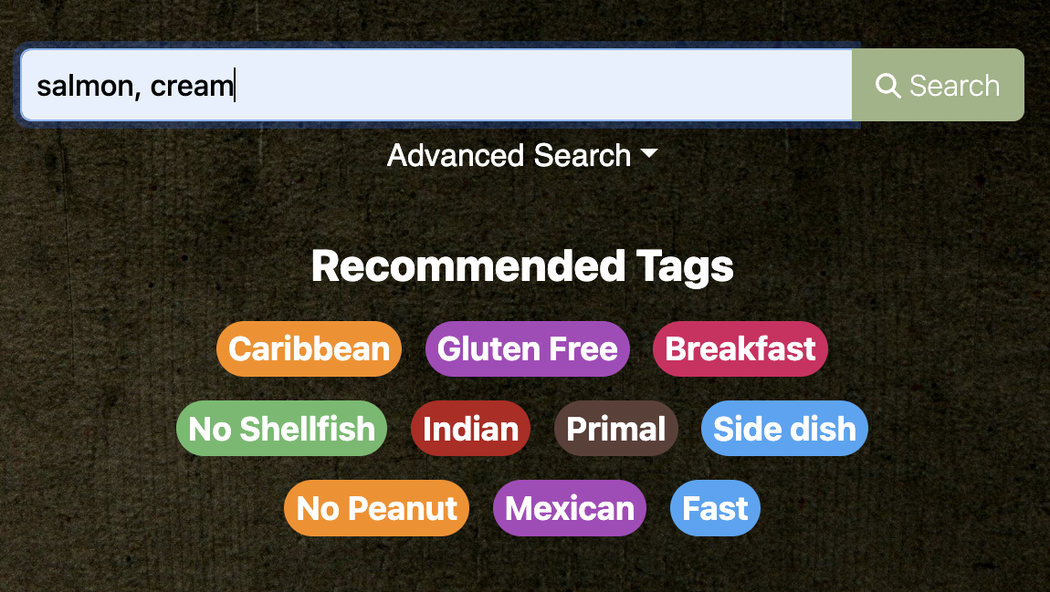
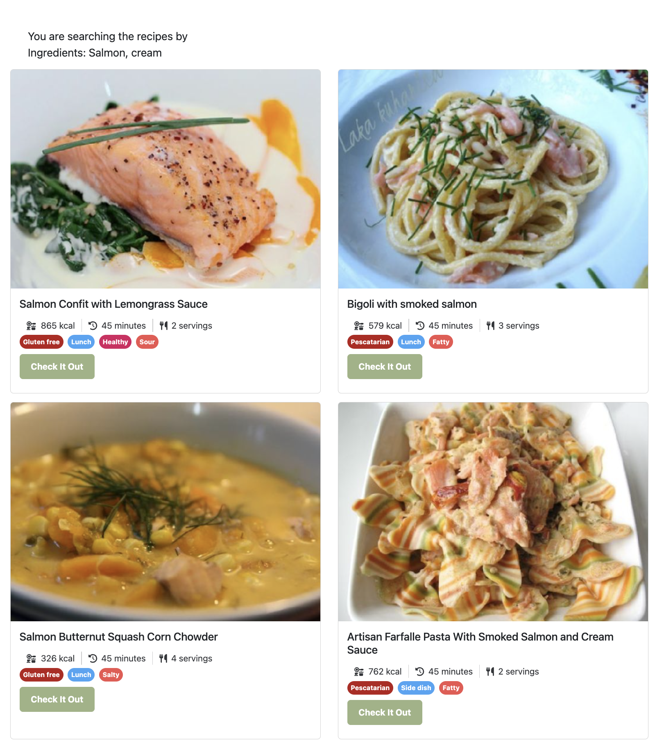
01
Search By Ingredients
Get recipes with the ingredients that the user has
Get recipes by keywords
E.g., “apple”, “carrot”, “cabbage”, “mozzarella”

Slide 6
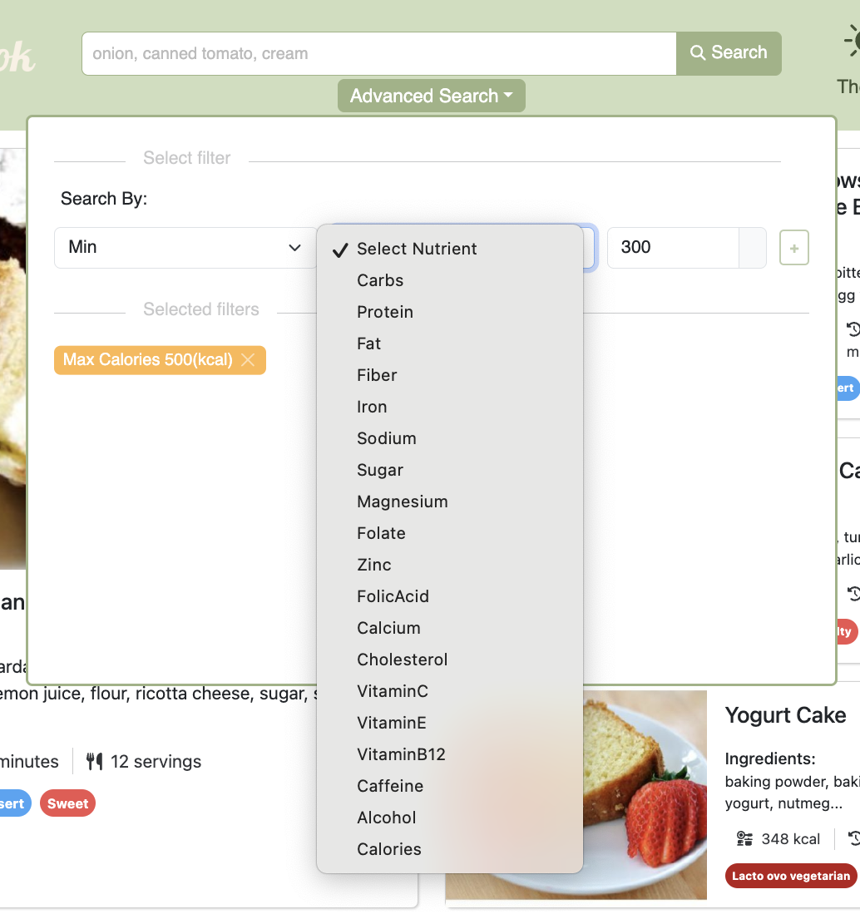
02
Search By Nutrients
Get recipes that fall within the specified min/max amount for certain nutrients
E.g., “calcium”, “protein”, “calories”, “caffeine”

Slide 7
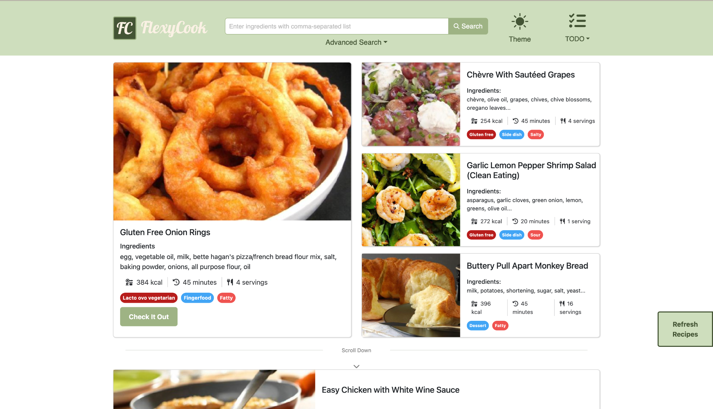
03
Recipe Recommendation
Prompt the user for random recipes
Tailor recipe recommendations until satisfied

Slide 8
Todoist
01
Cooking steps list
02
Shopping list
03
General todo list

Slide 9
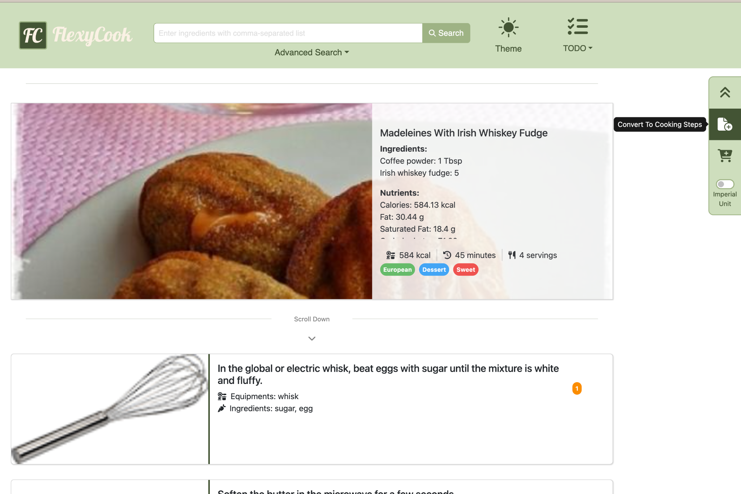
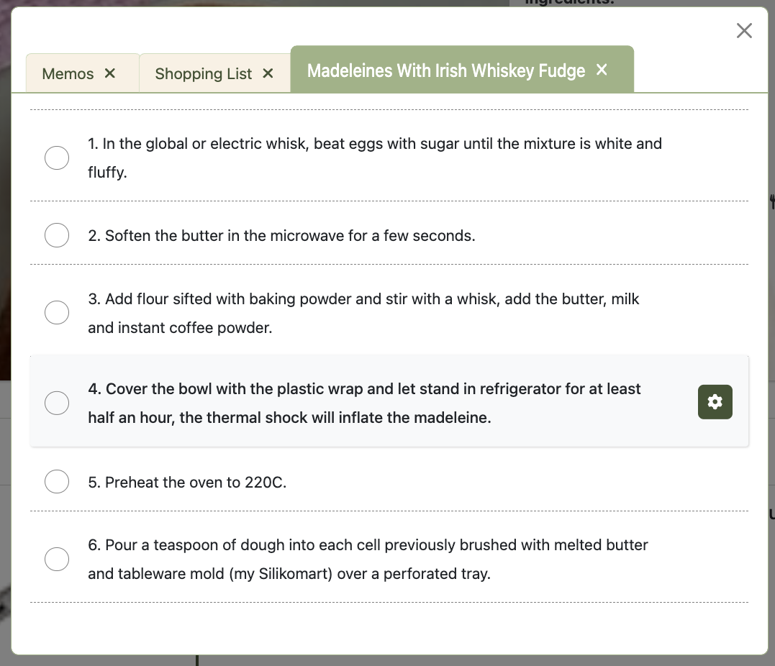
01
Cooking Steps
Create a list of cooking steps from the recipe
Easy to read
Save the steps and look back later

Slide 10
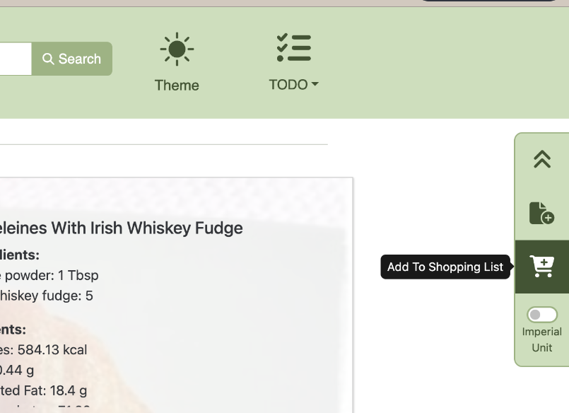
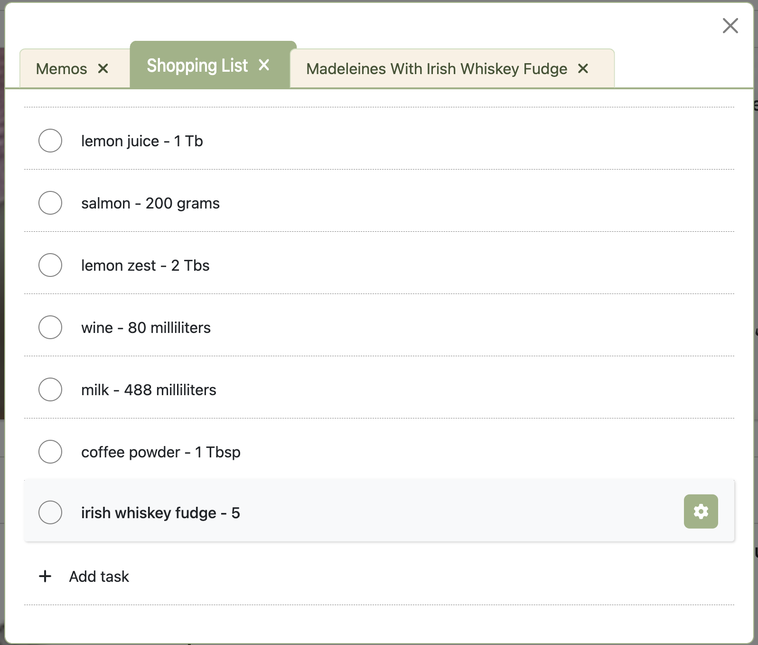
02
Shopping List
Add the ingredients from the recipe to the shopping list

Slide 11
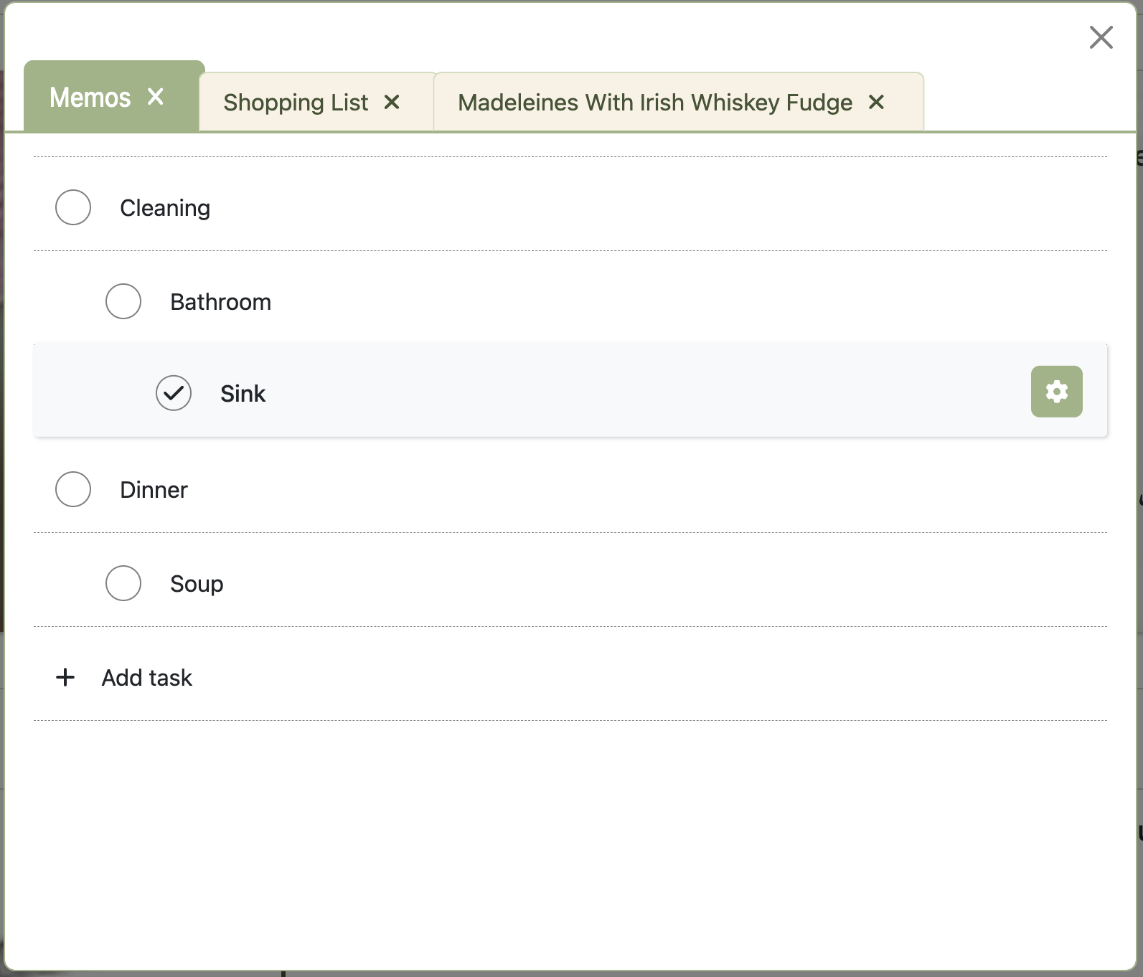
03
General Todo List
Used for task management as a general to-do list

Slide 12
CI/CD
Features developed in a separate branch
Automatic unit, integration and build tests
Separate development website for internal use
Automatic build & deploy
Public stable website for the users
Individual branch
Development
Production
Pull request
Staging
Reviewed by a teammate

Slide 13
What we learned
Coding
Teammates
Communications
Is actually only a part of development. It takes so much more to make a product.
I would not have been able to do half the things without my teammates’ help.
I learned so much from them.
Long meeting hours were rewarded by the results that are similar to our original ideas.

Slide 14
Next - Please Enjoy FlexyCook Demo Video
Background Music Used in demo video:
Music from #Uppbeat (free for Creators!): https://uppbeat.io/t/andrey-rossi/bunny-hop
License code: RYPJWY9NNZPLH28P

Slide 15


Slide 16
Thanks!
This presentation was created by the Group 4:
Fuka Nagata, Monica Gao and Yuna Hu

